Slide 1
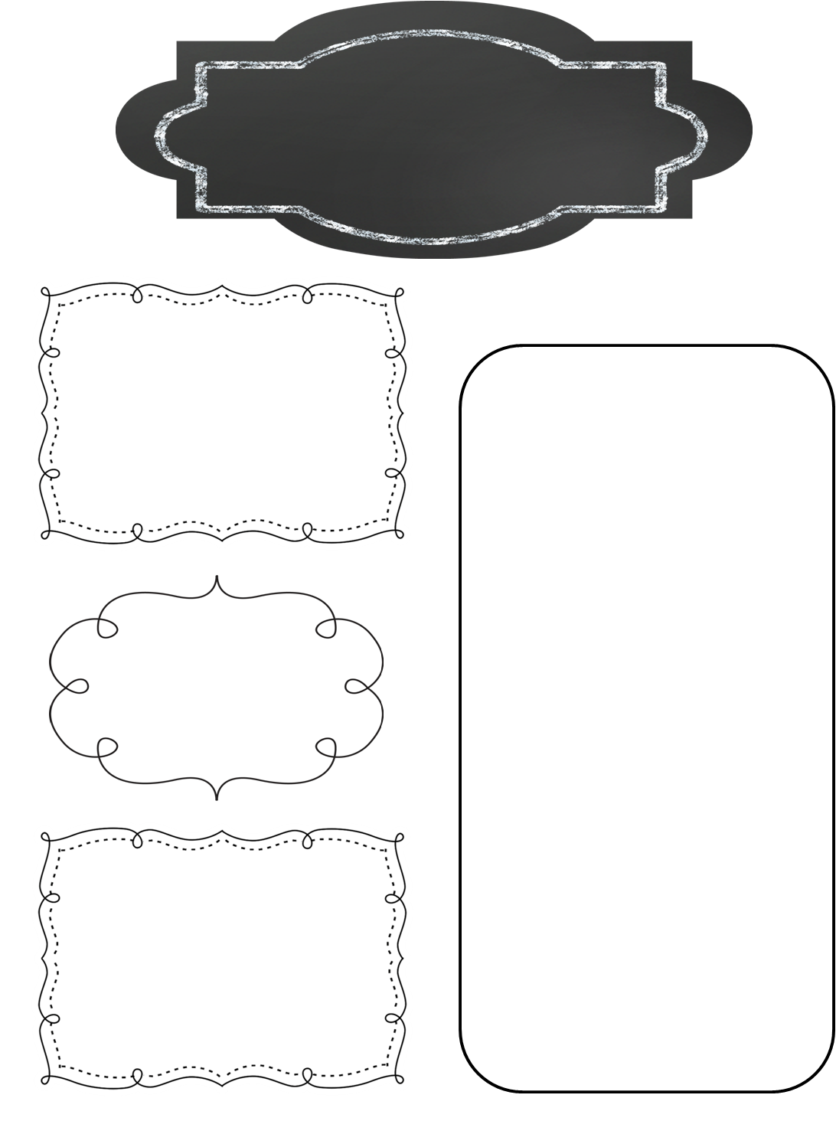
A Peek at This Week in…
Mrs. McFarland’s Class
Week of November 11th
Please continue to help your child review multiplication math facts. We will be having a math fact competition at the beginning of December to compete against other 5th grade homerooms.
Students should continue to read for AR. The deadline is December 19th. Students were assigned individualized points this time.
Reminders
Math (McFarland)
Multiplying and dividing decimals
Multiplying by powers of 10
Reading (McFarland)
Please see the attached Focus Wall for vocab words, spelling words, and skills/ strategies for U2L#8.
Vocab/comprehension/ language assessment is Friday.
Please check agendas nightly to review homework assignments with your student.
Spelling (McFarland)
Homophones
Test Friday
Upcoming Events
Language Arts/Writing (McFarland)
Wednesday, November 13th: Board meeting
Tuesday, November 26th: Progress reports go home
Thursday, November 28th: Happy Thanksgiving!!!
Friday, November 29th: NO SCHOOL
Wednesday, December 4-Friday, December 6: Penguin Patch Shop will be open
Friday, December 6th: Math Facts competition time TBA
Daily Proofreading
Conjunctions
Run-ons, compound and complex sentences
Science/ Social Studies (Eldridge)
Science: N/A
Social Studies: Declaration of Independence

